Slide 1
The Design of an AM Receiver
ELE 402 - Project
Mr. Chadi T. Chamoun
Ali Awada
Malak Darwish
Dana Hachem
Mahdi Zein Al Dine

Slide 2
Objective
Design and analyze an AM receiver circuit to recover audio signals from modulated RF input.

Slide 3
Wireless systems like Wi-Fi, mobile phones, and radios rely on analog circuits.
Real-world signals (e.g., audio) are low-frequency baseband signals (0–20 kHz).
These signals cannot be transmitted efficiently on their own due to antenna limitations.
They are modulated onto a high-frequency radio frequency carrier for transmission: a process called modulation.
This project focuses on Amplitude Modulation (AM), where the carrier’s amplitude varies with the baseband signal.

Slide 4
Demodulator
To recover a baseband signal, the received RF signal is typically:
- Multiplied by a carrier wave.
- Passed through a low-pass filter to extract the original low- frequency content.
However, for AM signals, a simpler amplitude detection method can be used.
A demodulator circuit is used to extract the original baseband signal from a modulated carrier wave.
It performs the reverse process of modulation.

Slide 5
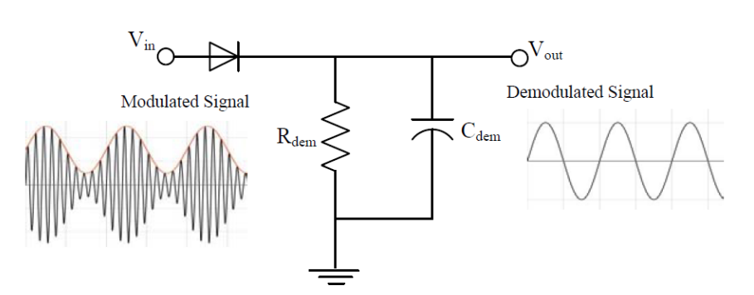
Connections

Slide 6
Components
Rdem=1kΩ
Cdem=2nF
Germanium diode
Using CH1 of the FG, we generate a signal with carrier frequency of 800kHz and 2Vpp amplitude
Using CH2 of the FG we generate a signal with frequency 0-20kHz and 2Vpp amplitude
We modulate the signal with a 100% modulation index
For smoother output, we add a low pass filter
components:
R=510Ω
C=1nF

Slide 7
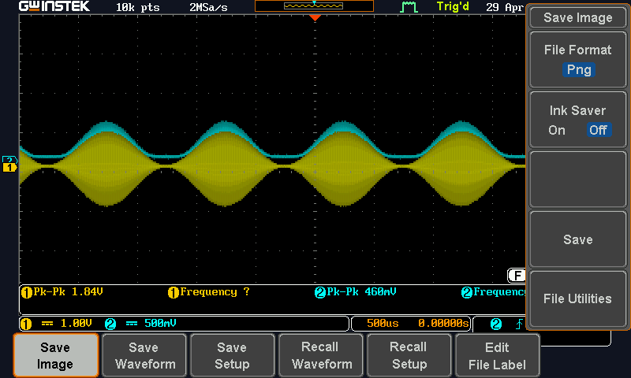
01.
Objectives
You can enter a subtitle here if you need it

Slide 8
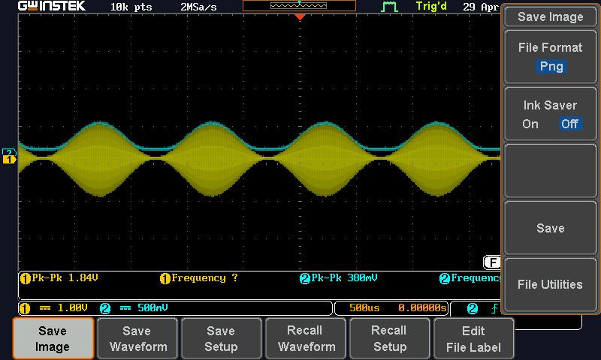
For smoother output, we add a low pass filter
components
R=510
C=1nF

Slide 9
Baseband Amplifier
After pre-amplification and demodulation, the extracted audio signal is typically weak.
An amplifier circuit is used to boost the audio signal to a usable level.
This design uses a non-inverting amplifier topology and allows for manual gain control using a potentiometer.

Slide 10
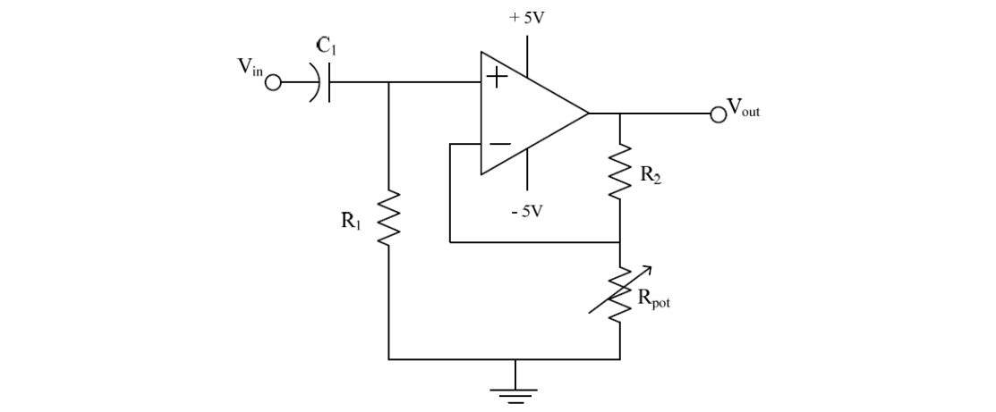
Connections

Slide 11
Components and voltage divider
The gain of the circuit needs to be 150k
However, output voltage from stage 1 was around 500mV
We build a voltage divider at the input of stage 2 followed by a coupling capacitor (470Ω resistor 10kΩ resistor)
Operational amplifier model: TL084
Vcc +5
Vee -5
R1=150kΩ
C1=1uF
R2=150kΩ
Rpot=1kΩ

Slide 12
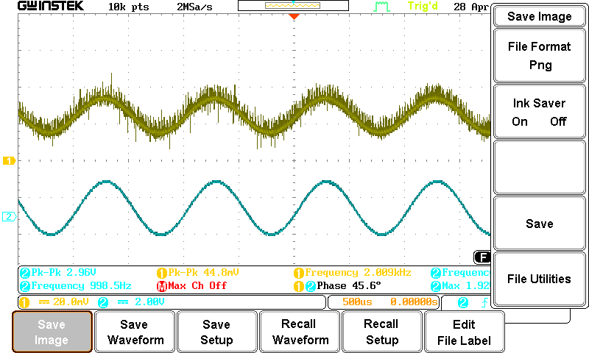
01.
03.
Results Analysis
02.
Methodology
04.
Conclusions
Here you could describe the topic of the section
Here you could describe the topic of the section
Here you could describe the topic of the section
Here you could describe the topic of the section

Slide 13
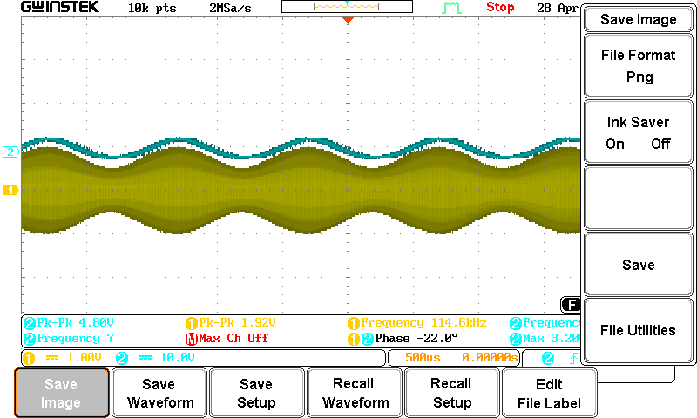
01.
03.
Results Analysis
02.
Methodology
04.
Conclusions
Here you could describe the topic of the section
Here you could describe the topic of the section
Here you could describe the topic of the section
Here you could describe the topic of the section

Slide 14
Class A Output Stage
Speakers consist of a coil with a magnetic core, attached to a diaphragm.
They are low impedance devices (typically 8–32 Ω).
AC current through the coil creates a magnetic field, moving the coil back and forth.
This motion drives the diaphragm to produce sound waves.
High output power (large current) is needed to drive the speaker.
A power amplifier is used between the baseband amplifier and the speaker.
A simple emitter follower (biased at high current) can serve this purpose.
It lowers output impedance, minimizing the speaker's leading effect.

Slide 15
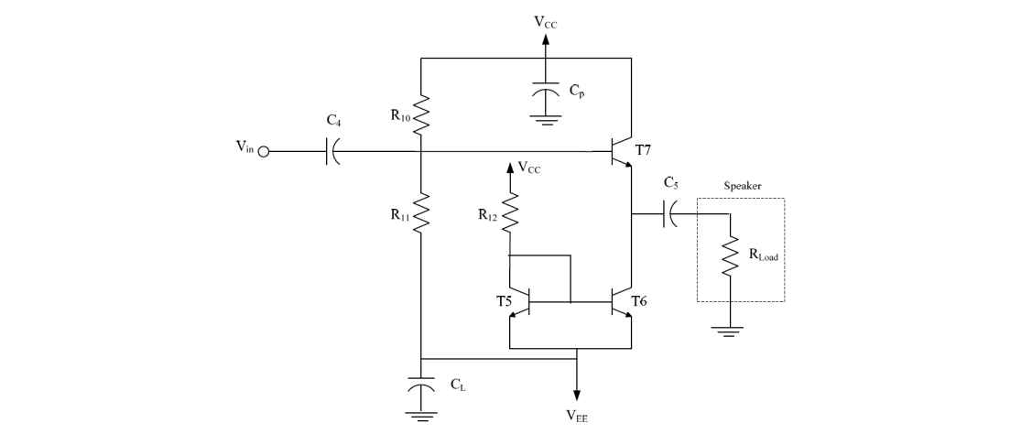
Connections

Slide 16
Components
NPN transistor model: MPS3704
Vcc +5
Vee -5
𝐶4 = 𝐶5 = 𝐶𝑃 = 𝐶𝐿 = 22𝜇F
R10= 200Ω
R11= 127Ω
𝑅12 = 127Ω
𝑅𝑙𝑜𝑎𝑑 = 8Ω

Slide 17
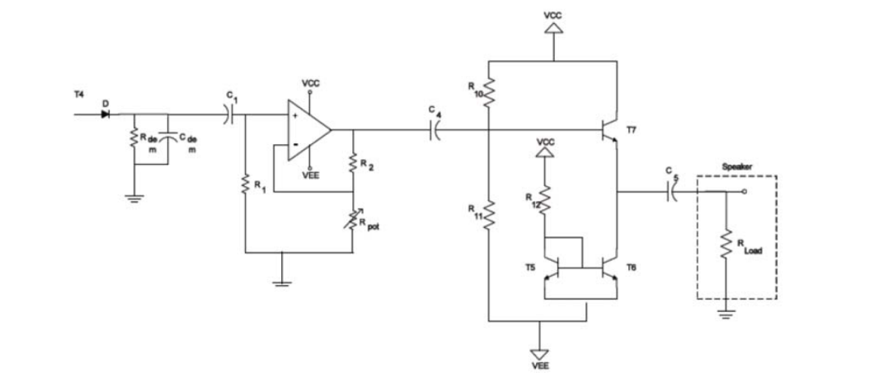
Final circuit

Slide 18
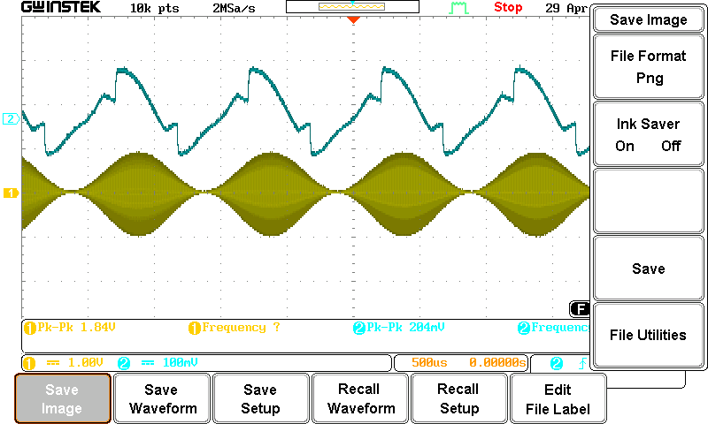
Schedule
 | Mon | Tue | Wed | Thu | Fri | Sat | Sun
Week 1 |  |  |  | 1 | 2 | 3 | 4
Week 2 | 5 | 6 | 7 | 8 | 9 | 10 | 11
Week 3 | 12 | 13 | 14 | 15 | 16 | 17 | 18
Week 4 | 19 | 20 | 21 | 22 | 23 | 24 | 25
Week 5 | 26 | 27 | 28 | 29 | 30

Slide 19
In our AM receiver design, we implemented a demodulator to extract the audio signal from the modulated carrier. This signal was then passed through a baseband amplifier to boost its strength for further processing. Finally, a Class A output stage was used to drive the speaker to ensure linear amplification and clear sound reproduction.

